Slide 1
Effective Identification and Engagement of Transportation Stakeholders Using Geospatial Analytics and Online Advertising
Okan Pala, Ph.D. | opala@ncsu.edu
George Orfanidis | orfanidisg2@winthrop.edu
Joseph E. Hummer | Chair
Jamille Robbins | Member
Anna Henderson | Member
Sean Epperson | Member
Terry Canales | Member
Mike Reese | Member
North Carolina State University

Slide 2
NCDOT Research & Innovation Summit 2020
Transportation Planning Process
Choice of site
Ranking transportation needs
Public input
Problem Statement
Local stakeholders are more likely to get involved in the planning process of it compared to commuting stakeholders
Some stakeholders participate in the planning of the project because they are skeptical about long term construction nearby.
Some stakeholders do not live in the vicinity of the project location and therefore they are
Not aware of the existence of the project
Not aware of the improvement that the project implementation would provide to them
Local: stakeholders that live or work in close proximity to the project’s location
Commuting: stakeholders that regularly commute near the project’s location

Slide 3

NCDOT Research & Innovation Summit 2020
Overarching Goal
NCDOT aims to gain the input from full spectrum of citizens
Involving the public early
Continued involvement

Slide 4
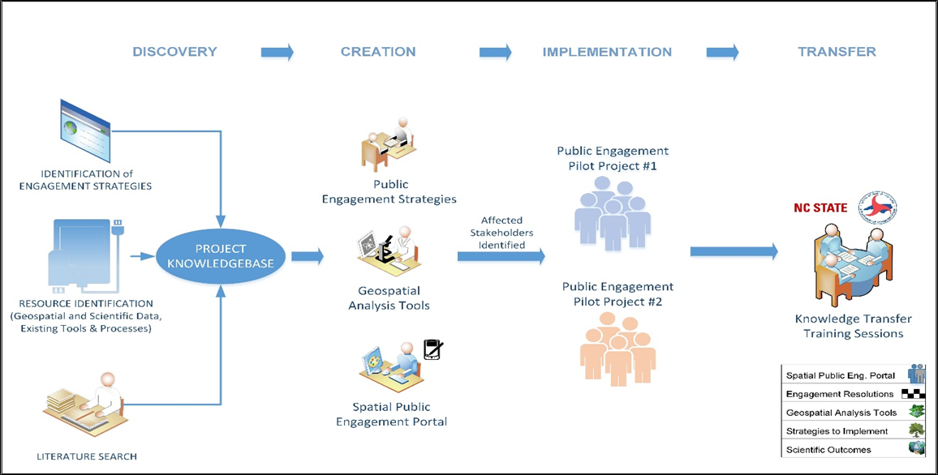
NCDOT Research & Innovation Summit 2020
Overview of the project

Slide 5
NCDOT Research & Innovation Summit 2020

Slide 6
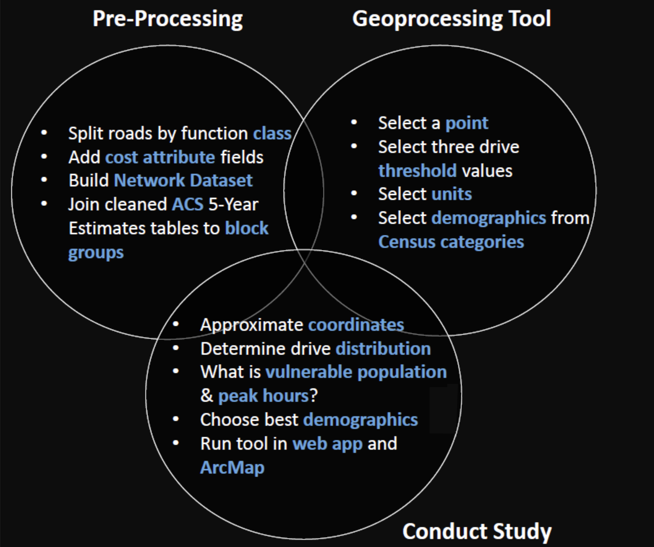
NCDOT Research & Innovation Summit 2020
Geospatial Analysis Tools
Network Analysis | Affected Areas | Areas with Demographic Interest

Slide 7
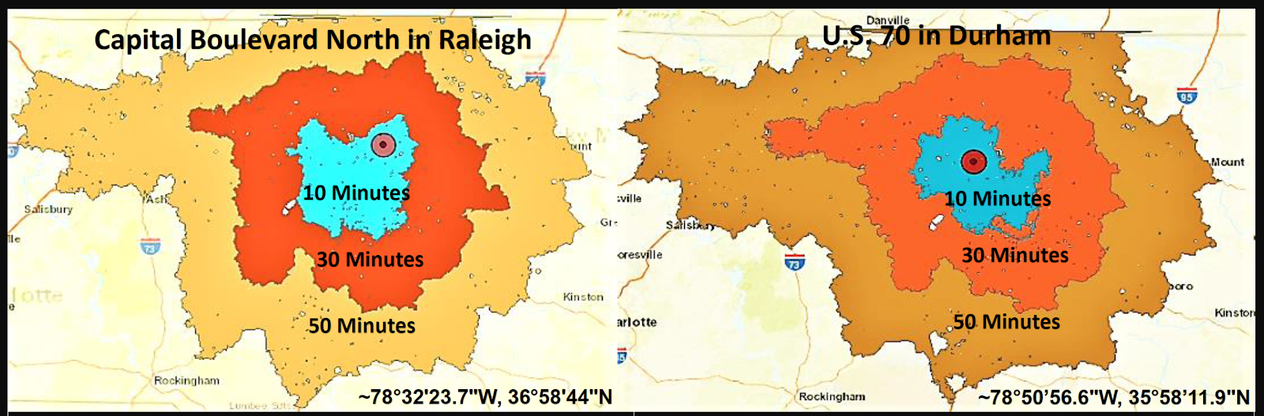
NCDOT Research & Innovation Summit 2020
Geospatial Analysis Tools
Network Analysis | Affected Areas | Areas with Demographic Interest

Slide 8
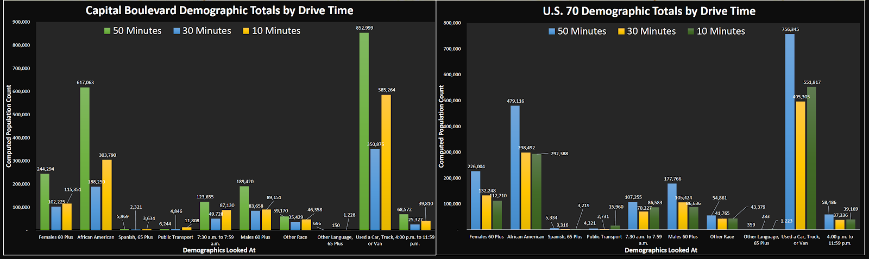
NCDOT Research & Innovation Summit 2020
Geospatial Analysis Tools
Network Analysis | Affected Areas | Areas with Demographic Interest

Slide 9
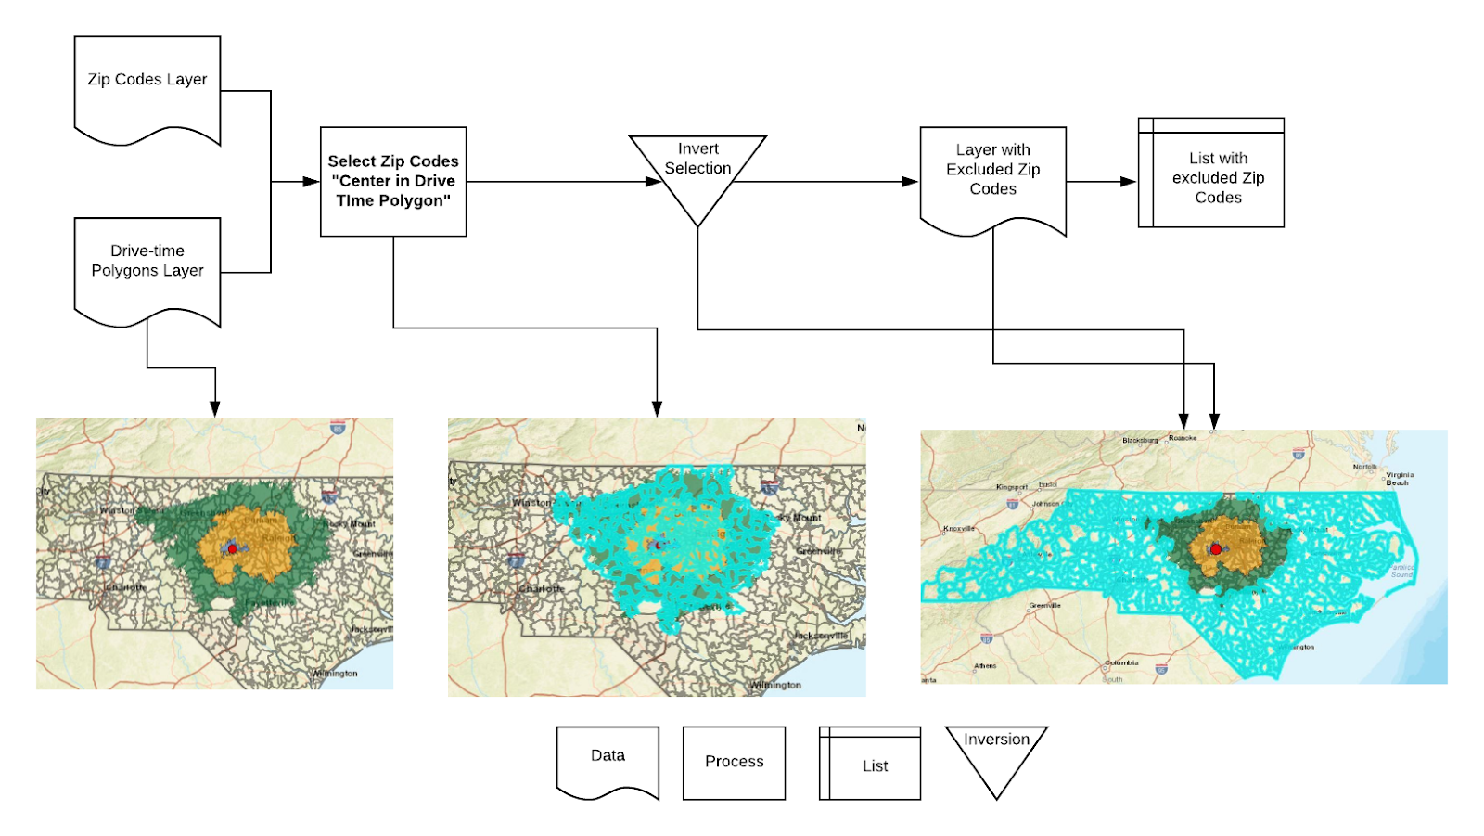
NCDOT Research & Innovation Summit 2020
Geospatial Analysis Tools
Network Analysis | Affected Areas | Areas with Demographic Interest

Slide 10
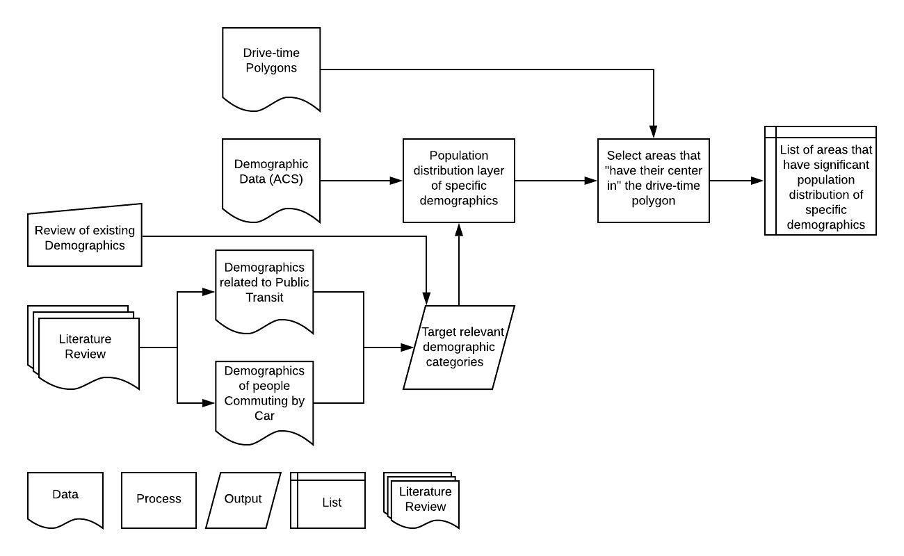
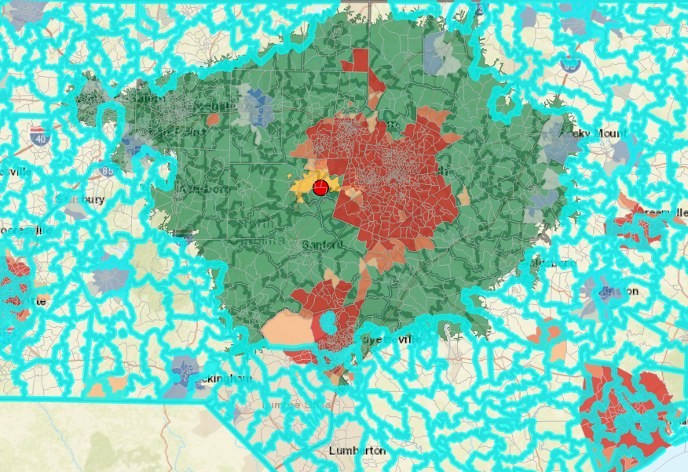
NCDOT Research & Innovation Summit 2020
Geospatial Analysis Tools
Network Analysis | Affected Areas | Areas with Demographic Interest

Slide 11


NCDOT Research & Innovation Summit 2020

Slide 12
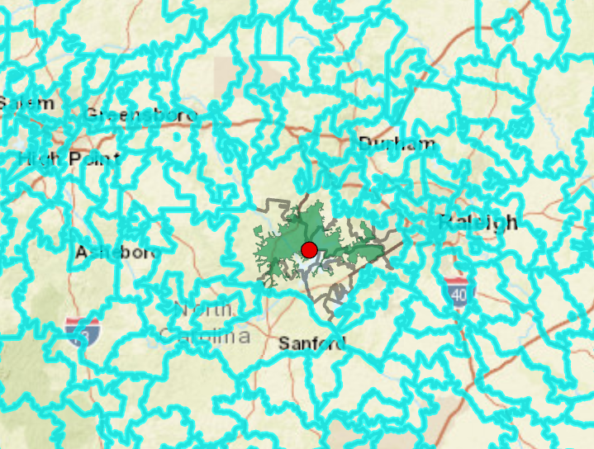

NCDOT Research & Innovation Summit 2020
Public Engagement Using Online Advertising
Target Local Stakeholders | Target Relevant but Nonlocal Stakeholders | Target Stakeholders with Relevant Demographic Profile
We aim to target stakeholders whose house/business is located in close proximity to the project’s site and as a result, they will be centrally affected by the implementation of the proposed project.

Slide 13
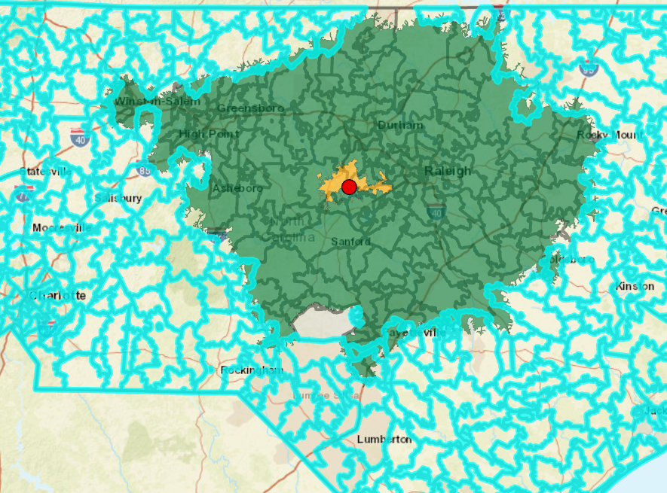
NCDOT Research & Innovation Summit 2020
Public Engagement Using Online Advertising
Target Local Stakeholders | Target Relevant but Nonlocal Stakeholders | Target Stakeholders with Relevant Demographic Profile
We aim to target migratorily affected stakeholders that regularly commute to the projects’ site.

Slide 14
NCDOT Research & Innovation Summit 2020
Public Engagement Using Online Advertising
Target Local Stakeholders | Target Relevant but Nonlocal Stakeholders | Target Stakeholders with Relevant Demographic Profile
We aim to target stakeholders that have a greater interest in the proposed transportation project.

Slide 15
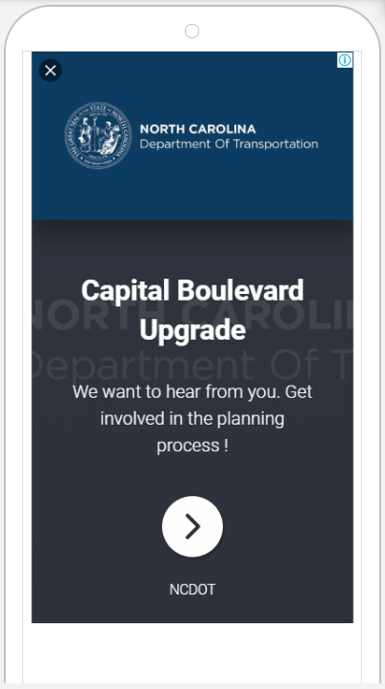

NCDOT Research & Innovation Summit 2020
Semi-Automated Creation of Advertising Campaigns
List with excluded Zip Code, US States and other counties
List with areas that have significant population density of specific demographics
Personalized Spatial Engagement Portal

Slide 16
NCDOT Research & Innovation Summit 2020

Slide 17
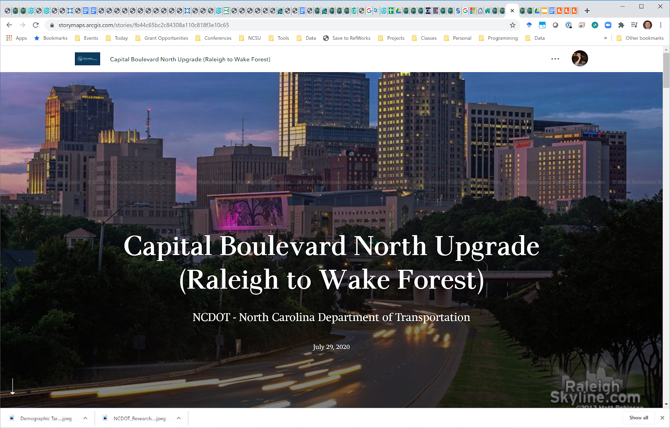
NCDOT Research & Innovation Summit 2020
Spatial Public Engagement Portal
Example Story Map:
https://storymaps.arcgis.com/stories/fb44c65bc2c84308a110c818f3e10c65
George’s summer research presentation video: https://www.youtube.com/watch?v=34KNasYnAio

Slide 18


NCDOT Research & Innovation Summit 2020
Thank you !
Any Questions?
Dr. Okan Pala | opala@ncsu.edu

